Slide 1

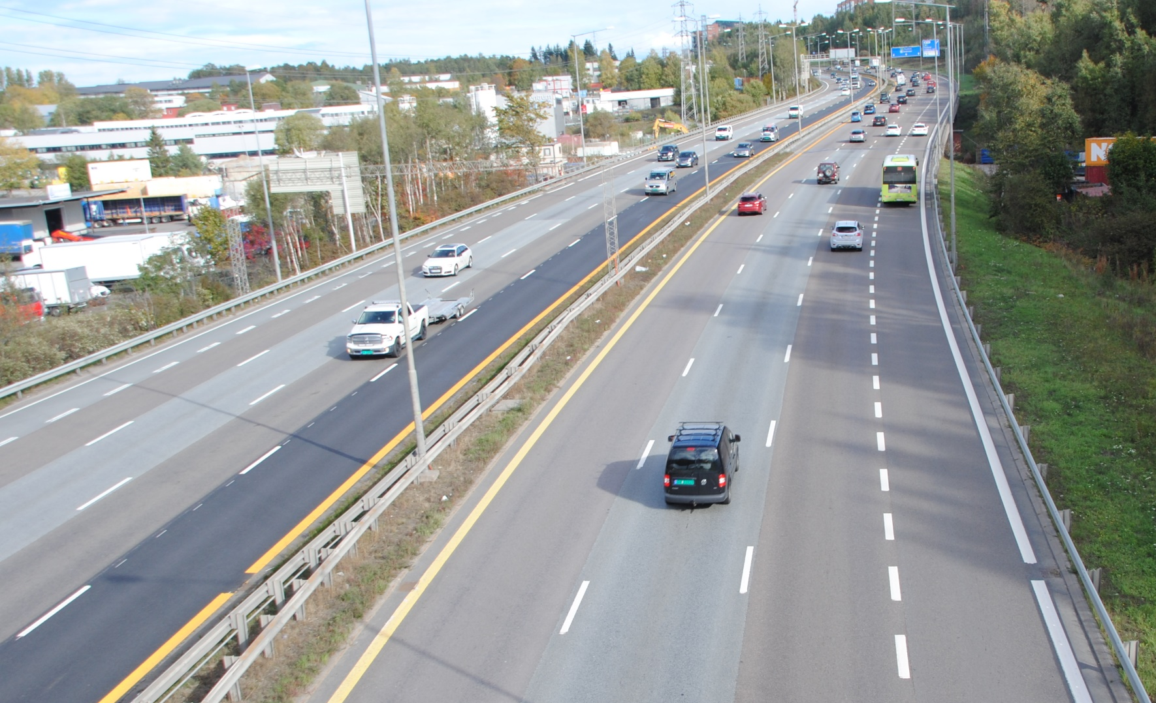

METREX LISBON E-CONFERENCE – July 1st 2020
FROM ROADS TO STREETS METREX EXPERT GROUP
Paul Lecroart, Senior Urbanist
L’Institut Paris Region, Paris Metropolitan Region Planning Agency
© Paul Lecroart Institut Paris Region
© De Gayardon Bureau

Slide 2
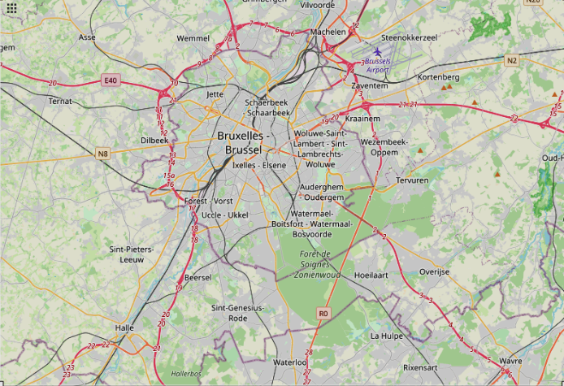
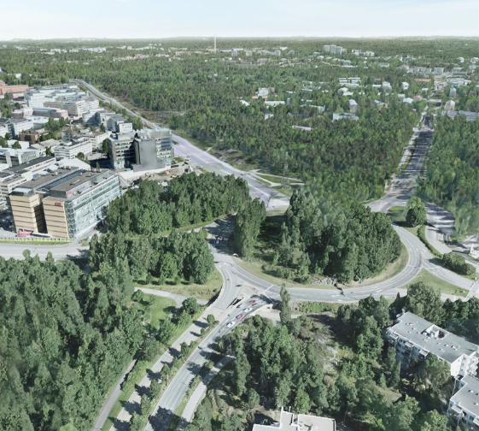
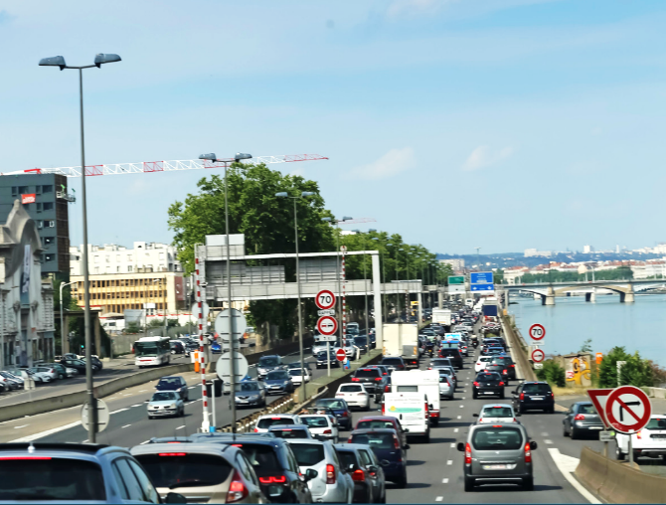
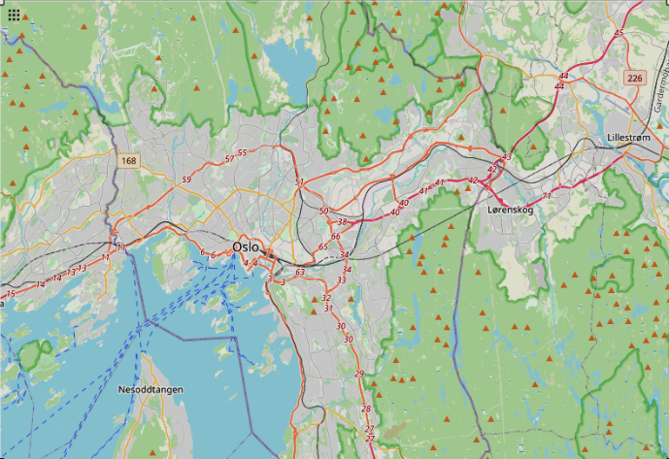
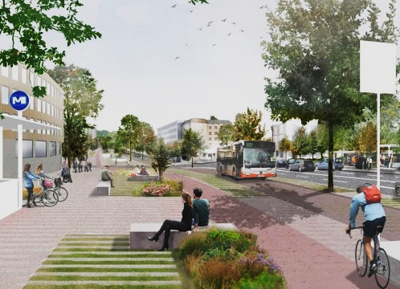
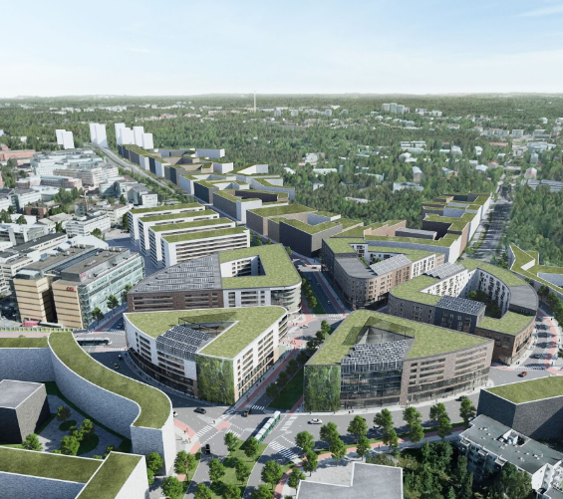
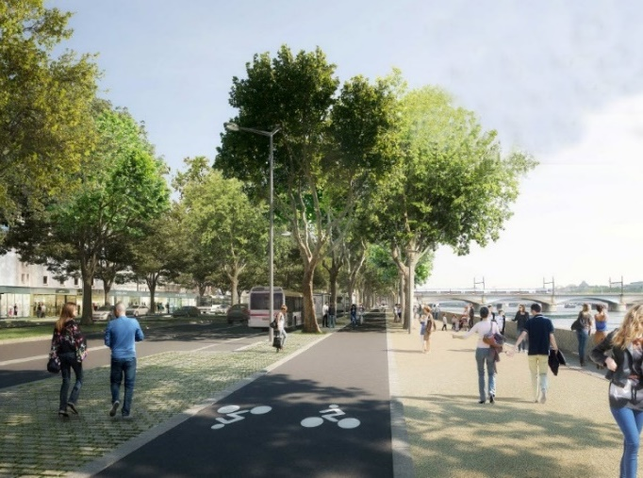
TRANSFORMING HIGHWAYS:A KEY TO LOW CARBON LIVEABLE CITY-REGIONS
Oslo
Østre Aker vei
Brussels
Delta Herrmann-Debroux
Helsinki Vihdintie/Huopalahdentie
Lyon
M6/M7
© City of Oslo
© Commune d’Auderghem
© City of Helsinki
© Perry Tak
© De Gayardon Bureau
© Perspective.brussels
© City of Helsinki
© UrbaLyon
Road section to be transformed: 1.4 km
Surface area of the regeneration project: 1100 ha
Road section to be transformed: 5 km
Surface area of the regeneration project: 43.5 ha
Road section to be transformed: 4 km
Surface area of the regeneration project: 137 ha
Road section to be transformed: 18 km

Slide 3
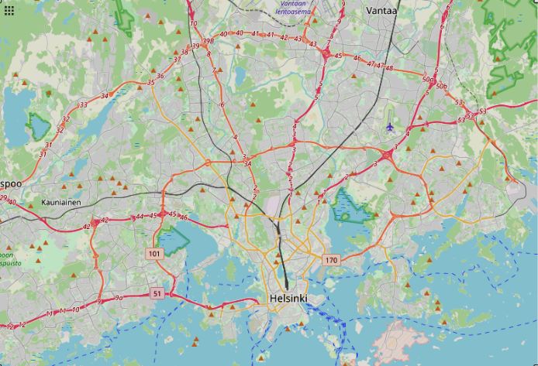
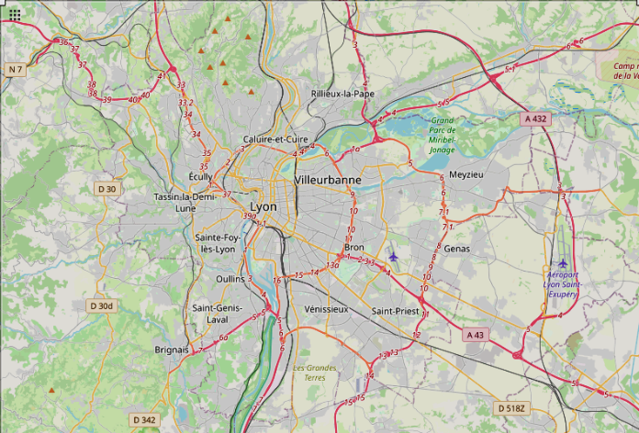
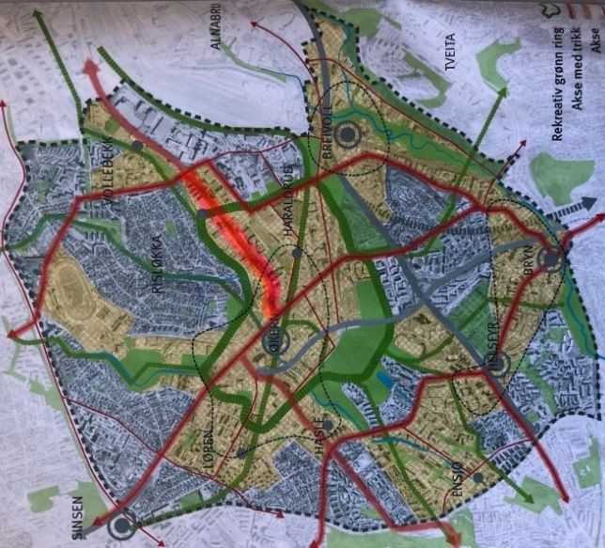
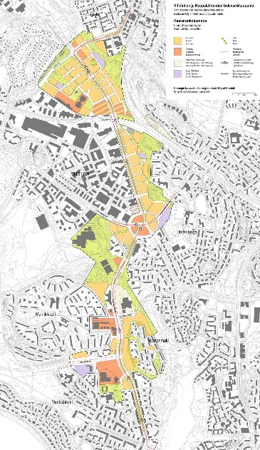
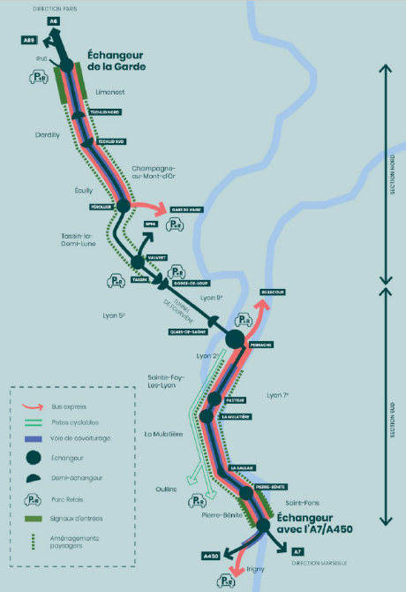
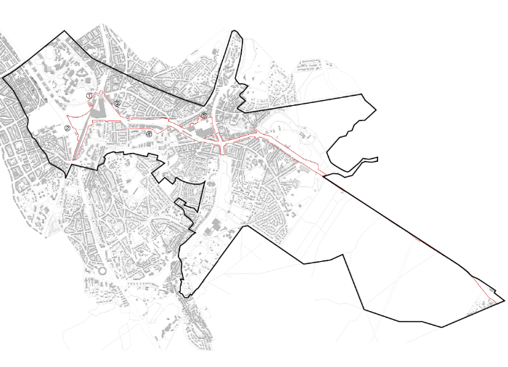
TRANSFORMING HIGHWAYS:A KEY TO LOW CARBON LIVEABLE CITY-REGIONS
Oslo
Østre Aker vei
Brussels
Delta Herrmann-Debroux
Helsinki Vihdintie/Huopalahdentie
Lyon
M6/M7
© City of Oslo
© Perspective.Brussels
© City of Helsinki
© UrbaLyon
Road section to be transformed: 1.4 km
Surface area of the regeneration project: 1100 ha
Road section to be transformed: 5 km
Surface area of the regeneration project: 43.5 ha
Road section to be transformed: 4 km
Surface area of the regeneration project: 137 ha
Road section to be transformed: 18 km

Slide 4

3-Networks Learning Platform METREX + EUROCITIES + URBACT
FROM ROADS TO STREETS METREX EXPERT GROUP
FROM ROADS TO STREETS RESEARCH
Birmingham
Lisbon
Rotterdam
Frankfurt
Amsterdam
Düsseldorf
Prag
Vilnius
Utrecht
Oslo
Brussels
Gothenburg
Helsinki
Lyon
Warsaw
Paris
Nantes
Barcelona AMB
Porto PMA
URBAN REGENERATION IN THE CITY FRINGE
EUROCITIES WORKING GROUP
Amsterdam VA
Gdansk-Gdnya GGSMA
Krakow KMA
Paris MGP
Manchester TfGM Thessaloniki MDAT
URBACT RICONNECT
NETWORK

